Slide 1
Run multi-container Docker applications
with Compose
These slides are to be used in conjunction with the lab document.

Slide 2
LEARNING OBJECTIVE
Run multi-container Docker applications with Compose.
Compose is a tool that uses a YAML file to configure your application’s services. Then, with a single command, you create and start all the services from your configuration.

Slide 3
INTRODUCTION
This lab provides you with an example to create and start multiple containers with Compose.

Slide 4
PREREQUISITES
Completed previous lab (7A)

Slide 5
LAB OUTLINE
Create Compose file
Run application with Compose

Slide 6
MANUAL SETUP VS COMPOSE
MANUAL | COMPOSE
docker network create <network> | docker-compose up
docker run --name book --network <network> -e dbURL=mysql+mysqlconnector://is213@host.docker.internal:3306/book <dockerid>/book:1.0
docker run -it --network <network> --rm <dockerid>/callbook:1.0
docker rm -f book | docker-compose down
docker rm -f callbook
docker network rm <network>

Slide 7
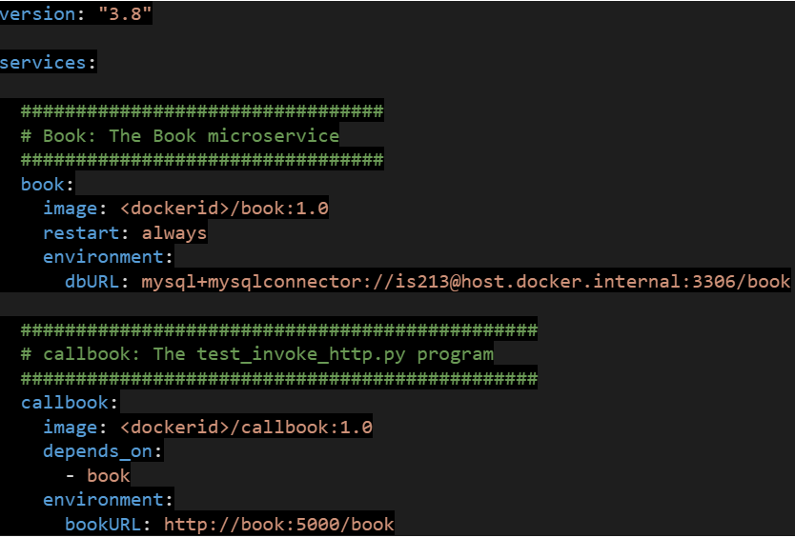
COMPOSE FILE

Slide 8
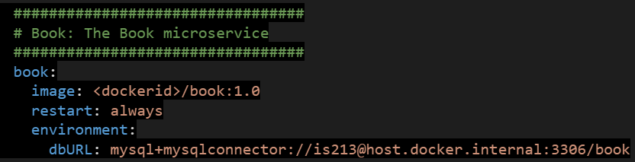
COMPOSE FILE
Roughly corresponds to:
docker run --name book -e dbURL=mysql+mysqlconnector://is213@host.docker.internal:3306/book eklum/book:1.0
service name
+
Auto network setup
Restart policy
environment variables
image

Slide 9
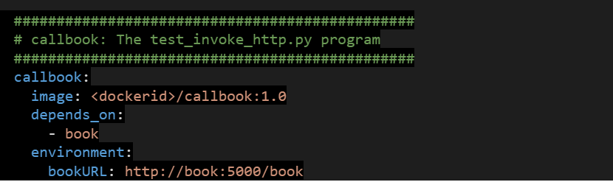
COMPOSE FILE
start (callbook) after these services
(book, etc)
Control startup order
+
etc*...
Notes:
* See https://docs.docker.com/compose/compose-file/compose-file-v3/ for more…

Slide 10
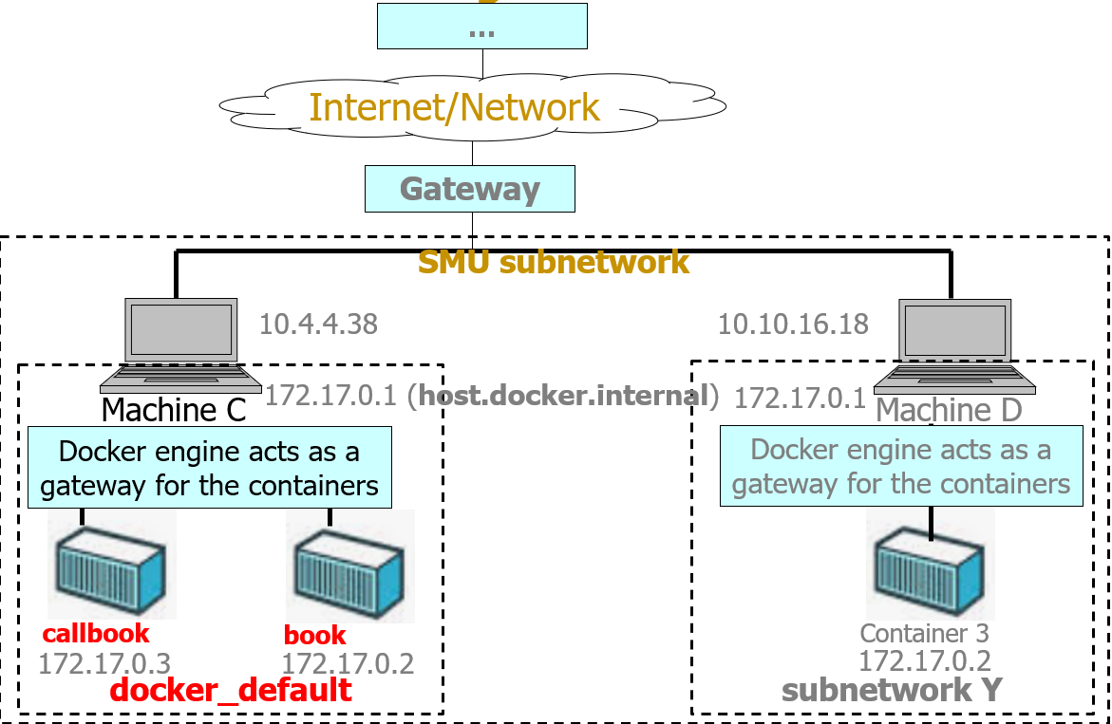
OVERVIEW
Notes:
Simplified networking diagram

Slide 11
LEARNING POINTS
Run multi-container Docker applications with Compose
Create compose file
Work with Docker Compose commands and options (docker-compose up, ps, down)

